Slide 1
Lecture # 6
Towers of Hanoi
Sorting Algorithms

Slide 2
Towers of Hanoi
It provides analysis of recursive algorithm
If rods = 3 and
rings = 64 of different sizes
All rings are arranged in decreasing size on rod 1 (the largest at the bottom and the smallest at the top)
Transfer all the rings to the 3rd rod
  Move one ring in one move
  No ring is even placed on top of another smaller one on any rod
Time required to finish this work for 64 rings is 500,000 million years if one ring is moved in one second. 2⁶⁴ = 18,446,744,073,709,551,616 Moves

Slide 3
A
B
C
Initial setup of Towers of Hanoi with n = 7

Slide 4
n = 3
(a) Initial
(1) A → C
(2) A → B
(3) C → B
(4) A → C
(5) B → A
(6) B → C
(3) A → C

Slide 5
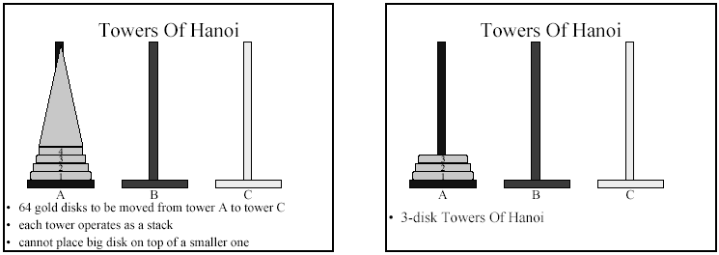
Towers of Hanoi

Slide 6
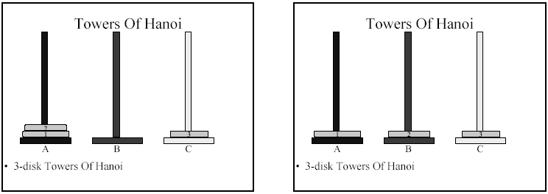
Towers of Hanoi

Slide 7
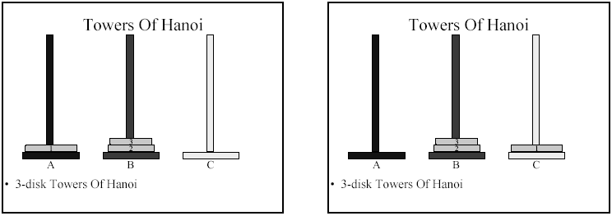
Towers of Hanoi

Slide 8
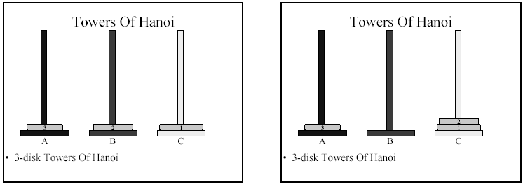
Towers of Hanoi

Slide 9
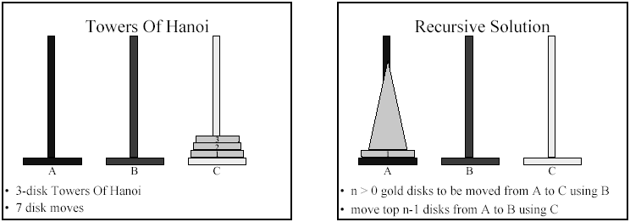
Towers of Hanoi

Slide 10
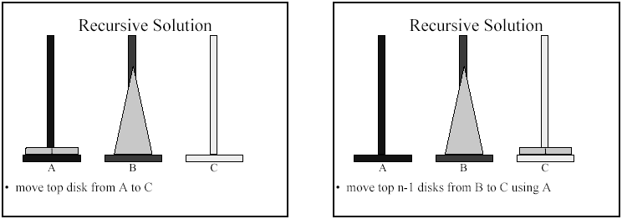
Towers of Hanoi

Slide 11
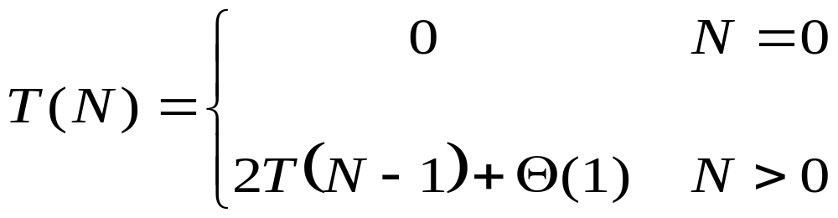
TOWER (N, BEG, AUX, END)
If N=1 then BEG "→" END
If N>1 then
Tower (N-1, BEG, END, AUX)
write BEG "→" END
Tower (N-1, AUX, BEG, END)
Let T(N) denote the number of times it is executed on a call of N.
Number of moves are: 2^{N}-1
Time to solve the problem with N rings = θ(2^{N})

Slide 12
n = 3
TOWER (1, A, B, C)
A → C
TOWER (2, A, C, B)
A → B
TOWER (1, C, A, B)
C → B
TOWER (3, A, B, C)
A → C
TOWER (1, B, C, A)
B → A
TOWER (2, B, A, C)
B → C
TOWER (1, A, B, C)
A → C

Slide 13
n = 3
(a) Initial
(1) A → C
(2) A → B
(3) C → B
(4) A → C
(5) B → A
(6) B → C
(3) A → C

Slide 14
n = 4
TOWER (1, A, C, B)
A → B
TOWER (2, A, B, C)
A → C
A → C
TOWER (1, B, A, C)
B → C
TOWER (3, A, C, B)
A → B
A → B
TOWER (1, C, B, A)
C → A
TOWER (2, C, A, B)
C → B
C → B
TOWER (1, A, C, B)
A → B
TOWER (4, A, B, C)
A → C
A → C
TOWER (1, B, A, C)
B → C
TOWER (2, B, C, A)
B → A
B → A
TOWER (1, C, B, A)
C → A
TOWER (3, B, A, C)
B → C
B → C
TOWER (1, A, C, B)
A → B
TOWER (2, A, B, C)
A → C
A → C
TOWER (1, B, A, C)
B → C

Slide 15
Non Credit Assignment
Implement the problem of Towers of Hanoi in any language of your choice.
Also view that increasing N how much your system becomes slow down.

Slide 16
Selection Sort
The basic idea of Selection Sort is to make a number of passes through the list or part of the list and, on each pass, select one element to be correctly positioned.
For example, on each pass through a sub list, the smallest element in the sub list might be found and then moved to its proper location.

Slide 17
As an illustration, suppose that following list has to be sorted into ascending order :
67 33 21 84 49 50 75
We scan the list to locate the smallest element and find it in position 3:
Then we interchange this element with the first element and thus properly position the smallest element at the beginning of the list.
21 33 67 84 49 50 75

Slide 18
We now scan the sub list consisting of the elements from position 2 on to find the next smallest element
21 33 67 84 49 50 75
and exchange it with the second element (itself in this case ) and then properly position the next-to-smallest element in position 2
We continue in this fashion, locating the smallest element in the sub list of elements from position 3 and interchanging it with the third element, then properly positioning the smallest element in the sub list of elements from position 4 on, and so on until we eventually do this for the sub list consisting of the last two elements as follows.

Slide 19
21 33 49 84 67 50 75
21 33 49 50 67 84 75
21 33 49 50 67 84 75
21 33 49 50 67 75 84
Positioning the smallest element in this last sub list obviously also positions the last element correctly and thus completes the sort.

Slide 20
Analysis of Selection Sort
Looking to the above algorithm of selection sort we observe that on the first pass through the list, the first item is compared with each of n-1 elements that follow it.
On the second pass, second element is compared with the n-2 elements following it and so on. So a total of
(n-1) + (n-2) + (n-3) + ….. + 2 + 1 = n(n-1)/2
comparisons are required for any list.

Slide 21
and
(n-1) + (n-2) + (n-3) + ….. + 2 + 1 = n(n-1)/2
= (n² – n)/2
= n²/2 – n/2
= 0.5n² – 0.5n
So ignoring smaller terms and coefficients we conclude that the worst case computing time for selection sort is O(n²).

Slide 22
Exchange Sort ( Bubble Sort )

Slide 23
Exchange sort systematically interchange pairs of elements that are out of order until eventually no such pairs remain and the list is therefore sorted.
To illustrate bubble sort, consider the following list
67 33 21 84 49 50 75

Slide 24
On the first pass, we compare the first two elements, 67 and 33 and interchange them because they are out of order.
67 33 21 84 49 50 75
33 67 21 84 49 50 75
Now we compare the second and third elements, 67 and 21 and interchange them
33 21 67 84 49 50 75

Slide 25
Next we compare 67 and 84 but do not interchange them because they are already in the correct order.
33 21 67 84 49 50 75
Next 84 and 49 are compared and interchanged.
33 21 67 49 84 50 75
Then 84 and 50 are compared and interchanged.
33 21 67 49 50 84 75
Finally 84 and 75 are compared and interchanged.
33 21 67 49 50 75 84
So the first pass through the list is now complete.

Slide 26
We are guaranteed that on this pass, the largest element in the list will go down to the end of the list, since it will obviously be moved and pass all smaller elements.
But notice that some of smaller items have “Bubbled Up” toward their proper positions nearer the front of the list.
So we scan the list again but this time we ignore the last item because it is already in its proper location.
33 21 67 49 50 75 84
So in each pass the last element will be placed in its proper location in the sub list.

Slide 27
The worst case of bubble sort occurs when the list elements are in reverse order because in this case only one item ( the largest ) item is placed correctly on each pass through the list.
On the first pass through the list n-1 comparisons and interchanges are made and only the largest element is correctly positioned.
On the next pass, sub list consisting of the first n-1 elements are scanned; there are n-2 comparisons and interchanges; and the next largest element sink to position n-1.

Slide 28
Finally, process continues until the sub list consisting of the first two elements is scanned and on this pass there is one comparison & interchange.
Thus a total of
(n-1) + (n-2) + (n-3) +…….. + 1 = n(n-1)/2
= n²/2 – n/2
Comparisons and interchanges are required. It follows that worst case computing time for Bubble Sort is O ( n² )

